Slide 1
Certificate in Digital Applications – Level 02
Creative Multimedia – DA202
Unit 02 – Digital Showcase - DA202
ICT Dept

Slide 2
Assignment Scenario
Assignment
Checklist
LO1
LO2
LO3
LO4
LO5
LO6
CLIENT PROPOSAL – prepared by the “One World” Showcase company
‘One World’ is an opportunity to get involved in the world of media and television. ‘One World’ experts preview news broadcasts created by young people and arrange for the best to be shown on community television channels.
You must produce a news broadcast for the ‘One World’ experts to preview. This will be a multimedia broadcast that features a headline story about youth achievement.
You will choose the target audience and a title for your broadcast. Within this broadcast there needs to be a range of media content to make it look and feel more professional . You will be required to produce a videoed weather forecast that will be shown during the news broadcast.
A range of youth achievements in the area will need to be highlighted, these could include community support, sport, local educational achievements or anything that requires merit.

Slide 3
Assignment Scenario
Assignment
Checklist
LO1
LO2
LO3
LO4
LO5
LO6
Broadcast Overview:
Your news broadcast must:
be between 3 and 4 minutes long and include:
opening and closing sequences
a welcome video clip
a headline story
a continuity sequence
a weather forecast
play from beginning to end.
You must also produce a preview version that allows experts to navigate to components of the broadcast.

Slide 4
Learning Outcome 5 – Assignment
How the news leads from the story into the conclusion. Conclusion Sequence (P) Background (P) Titles and Logo (P) Presentation of elements (P) Suitable scene set (M) Animated titles (M) Presentation of elements (M) Appropriate theme set (D) Music accompaniment (D) Suitable logo included (D) Presentation of all elements (M)
 | To achieve a pass grade: Candidates will produce a basic Portfolio Presentation Website that contains a minimum 3 pages, Home Page, Context Page and Assets Page with working links and content. To achieve a merit grade: Candidates will produce a working Portfolio Presentation Website that contains multiple pages including a Home Page, Context Pages and Assets Pages with working links and appropriate content. To achieve a distinction grade: Candidates will produce a working Portfolio Presentation Website that contains multiple pages including a Home Page, Context Pages and Assets Pages with working links and appropriate content ands multimedia assets.
1

Slide 5
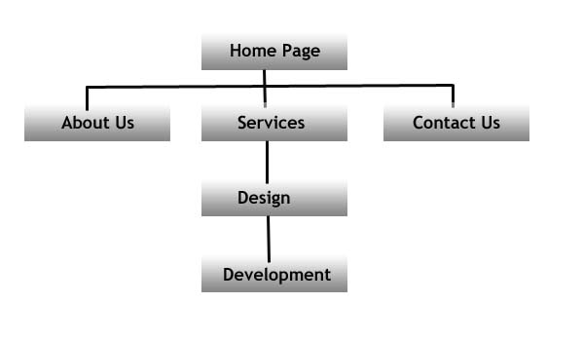
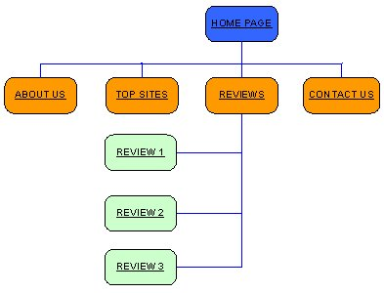
Learning Outcome 1 – Task 1
Flow diagrams How the user moves from page to page Alternative pathways Ease of Use (M/D) Logical Pathing (M/D) Well Structured Layout (D) ALL Appropriate (D)
Task 1 (P, M, D) It is important that the structure of your e-portfolio is logical so that the moderator can find all the evidence. You will need to create a structure chart for your e-portfolio showing how the pages link together. There will be a minimum of 3 pages for a Pass that should contain a Homepage and 2 Context page. A range of multimedia content should be on these pages but consistency of layout is important.
1 | Produce a Site plan with details of at least 3pages shown
 | Provide details of how the user will navigate between the pages

Slide 6
Learning Outcome 5 – Task 2
Structured layout of the page Browser resolution Appropriate Titles. Use of images on the webpage. Positioning of elements.
Task 2 (P) – ‘One World’ would like you to create an ePortfolio website that will link to all the elements of your portfolio of work. To do this they want you to use the structure chart to create the ePortfolio website and lay it out so that all the elements link together. This needs to be in a logical format and contain all the elements from your portfolio. This should also include: A home page showing: Your name and candidate number, centre name and number The title of this SPB (DA202 One World) The browser and resolution that should be used to view the ePortfolio (1024x600 preferably without scrolling) Links to the context pages Context pages with commentaries to introduce and link to the required evidence Appropriate multimedia assets on the pages.
2 | Produce a Homepage for the presentation of information with suitable content.

Slide 7
Learning Outcome 5 – Task 3
Consider of images and appropriateness (M) Sourced and stored from legitimate locations (M) Content related to local community (M) Quality of stored elements (D) Consideration of file size and file proportions (D)
Task 3 (M/D) – ‘One World’ would like you to find a range of appropriate multimedia elements that will make the ePortfolio more interesting and appealing to the target audience like sounds, images and videos. You will need to research and gather a range of images that best describe the content of the One World scenario. You should remember to source these images in a format that is in proportional to the screen dimensions, quality and subject.
3 | Source and store a range of images for the Community Animation Clip.
 | This content should can include at any appropriate elements that are locally relevant, in proportion and of good quality. Consideration of all the elements sources should be put into your source table from LO1. Consideration of copyright should also be given.

Slide 8
Learning Outcome 5 – Task 4
Consistent layout with the Context Pages Include all the content from the Portfolio. Function as links to all the content. Quality and integrity of Web Pages (M/D) Inclusion of all the ePortfolio elements in Products and Evidence (D)
Task 4 (P/M/D) –‘One World’ would like you to create an ePortfolio Context Page that links to all the assets in your ePortfolio Products and Evidence folders. This should be two additional pages: Products Page - this should contain the 3 preview links to sections of your portfolio and a full version link to your finished video Showcase. Evidence folder – This should include links to all the evidence documents, commentaries and Buddy reports created throughout this project. Comments should be made beside each link to explain to the company what they are clicking on and seeing.
4 | Produce at least two pages for the presentation of information with suitable content links.
 | The Pages need to be well designed and clearly labelled, and incorporate all the elements you have designed from the images to the storyboards for each stage of the project. Merit and Distinction grades are judged on the quality and functions of the Pages. Any additional Images used must be in your Assets Table. Get your Test Buddy to look over it to check for mistakes.

Slide 9
Learning Outcome 5 – Task 5
Testing links Testing content Testing spelling and grammar Testing layout Testing e-Portfolio Size (<30MB) Testing multimedia assets Ease of Use (M) Ease of Use (M) File compatibility (M) Ease of Navigation (D) Meeting the Needs of the Target Audience (D)
Task 5 (P/M/D) –‘One World’ would like you to test the ePortfolio website so that it functions are it is supposed to with links to all assets. This should be tested on a stand alone computer so that the moderator can view it with working links separate from the network. These tests should cover a wide range of features of your e-Portfolio site. Click here for a testing frame.
5 | Produce a test table to test the elements and functions of the ePortfolio website.
 | Tests should be evidenced and evidence of testing should be provided as a link on the Context Pages for the moderator to show that you have attempted to demonstrate a willingness to find faults and repair them. For Merit and Distinction grades, tests should also include non functional tests like Ease of Use and Meeting the Needs of the Target Audience.

Slide 10
LO5 – Assessment (P, M, D)
Task | Activities |  |  |  |  |  |  | Student |  | Staff
LO5: Be able to prepare and produce a Digital Showcase for the One World project
1 (P) | Produce a Site plan with details of at least 3pages shown
2 (P/M/D) | Produce a Homepage for the presentation of information with suitable content.
 | Appropriate (P) |  | Consideration of purpose (M) |  |  | Consideration of Ease of Use (D)
3 (M/D) | Source and store a range of images for the Community Animation Clip.
4 (P/M/D) | Produce at least two pages for the presentation of information with suitable content links.
 | Context Pages are functional(P) |  |  | Quality and integrity of Web Pages (M) |  |  | Inclusion of all the ePortfolio elements (D)
5 (P/M/D) | Produce a test table to test the elements and functions of the ePortfolio website.
 | Limited test(P) | Range of tests including non-functional (M) |  |  | Wide range of tests that meets the needs of the audience(D)

